Slide 2
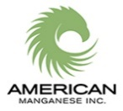
CAUTIONARY INFORMATION
This presentation contains “forward-looking information” which may include, but is not limited to, statements with respect to the future financial or operating performance of American Manganese Inc., its subsidiaries and its projects, the estimation of mineral reserves and resources, the realization of mineral reserve estimates, the timing and amount of future production, costs of production, capital, operating and exploration expenditures, costs and timing of development of new deposits, costs and timing of future exploration, requirements for additional capital, government regulation of mining operations, environmental risks, reclamation expenses, title disputes or claims and limitations of insurance coverage. Often, but not always, forward-looking statements can be identified by the use of words such as “plans”, “expects”, “is expected”, “budget”, “scheduled”, “estimates”, “forecasts”, “intends”, “anticipates”, or “believes” or variations (including negative variations) of such words and phrases, or state that certain actions, events or results “may”, “could”, “would”, “might” or “will” be taken, occur or be achieved. Forward-looking statements involve known and unknown risks, uncertainties and other factors which may cause the actual results, performance or achievements of American Manganese Inc., and/or its subsidiaries to be materially different from any future results, performance or achievements expressed or implied by the forward-looking statements. Such factors include, among others, general business, economic, competitive, political and social uncertainties; the actual results of current exploration activities; actual results of reclamation activities; conclusions of economic evaluations; changes in project parameters as plans continue to be refined; possible variations of ore grade or recovery rates; failure of plant, equipment or processes to operate as anticipated; accident, labor disputes and other risks of the mining industry; and delays in obtaining governmental approvals or financing or in the completion of development or construction activities. Although American Manganese Inc. has attempted to identify important factors that could cause actual actions, events or results to differ materially from those described in forward-looking statements, there may be other factors that could cause actions, events or results to differ from those anticipated, estimated or intended. Forward-looking statements contained herein are made as of the date of this presentation and American Manganese Inc. disclaims any obligation to update any forward-looking statements, whether as a result of new information, future events or results or otherwise. There can be no assurance that forward-looking statements will prove to be accurate, as actual results and future events could differ materially from those anticipated in such statements. American Manganese Inc. undertakes no obligation to update forward-looking statements if circumstances or management’s estimates or opinions should change. Accordingly, the reader is cautioned not to place undue reliance on forward-looking statements.
Cautionary note to United States Investors concerning estimates of Measured, Indicated and Inferred Resources: This presentation uses the terms “Measured”, “Indicated” and “Inferred” Resources. United States investors are advised that while such terms are recognized and required by Canadian regulations (under National Instrument 43-101 Standards of Disclosure for Mineral properties), the United States Securities and Exchange Commission does not recognize them. United States investors are cautioned not to assume that all or any part of Measured or Indicated Resources will ever be converted into Mineral Reserves.
Slide No. 2 – May 9, 2017

Slide 3
INDEX
Summary
Share Capital
Biography of Presenter
Corporate Objective and Strategy
Technology History
Recycling Technology
The Problem
The Opportunity
Customers
Market Size
Competitors
Battery Chemistry and Economics
Cathode Materials are Critical and Strategic
Cobalt Production Dynamics
Cobalt Production Chart
Cobalt Twelve (12) Year Chart
Cobalt Produced Annually
Global Lithium Prices
Disassembly of a Tesla Battery Cell
Milestones
Artillery Peak, Arizona
Niobium Properties, BC
Rocher Deboule – IOCG, BC
Summary
Contact Information
Slide No. 3– May 9, 2017 AMERICAN MANGANESE INC. TSX.V: AMY PINK: AMYFZ FRANK: 2AM www.amymn.com

Slide 4
AMERICAN MANGANESE INC. - SUMMARY
Leader in Lithium Ion Electric Vehicle Battery Recycling
Mining Batteries Eliminates Mining Ore
Valuable Cathode Materials (Cobalt) Delivered to Our Door Step ($3.00/lb Tipping Fee)
Business Opportunity in Recycling Plants
Equity Investment Participation in Disruptive Technology Critical to the Production of Electric Cars
Slide No. 4– May 9, 2017 AMERICAN MANGANESE INC. TSX.V: AMY PINK: AMYFZ FRANK: 2AM www.amymn.com

Slide 5
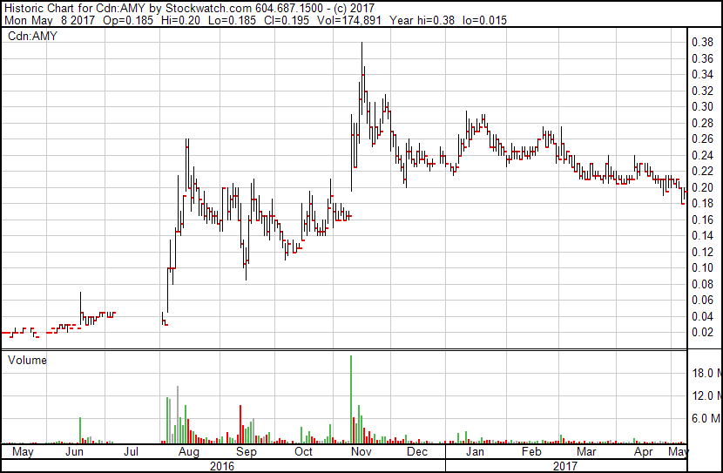
AMERICAN MANGANESE INC. - SHARE CAPITAL
Shares Structure – May 8, 2017
Market Cap Undiluted----------------------- $30.0 Million
Diluted ------------------------- $35.8 Million
Basic Issued and Outstanding Shares ------- 139,647,169
Warrants and Options Shares--------------- 31,059,790
Fully Diluted ---------------------------------- 170,706,959
Warrants and Options Diluted $----------- $3,472,308
52-Week High/Low --------------------------- C$0.38 - $0.01
Listing: Common Shares -------------------- TSX.V: AMY
Pink Sheets: AMYZF.pk Frank: 2AM

Slide 6
BIOGRAPHY OF THE PRESENTER
LARRY W. REAUGH President and Chief Executive Officer of American Manganese Inc. from February 1998 to present.
Mr. Reaugh has fifty-three years’ experience in the mining industry and for the past thirty-five years he has been the CEO and President of several exploration, development, production companies and 12 years in internet and technology companies listed on the TSX, TSX Venture and NSDAQ exchanges.
Several of his companies have made significant discoveries, three of which (gold) went on to be producing mines.
Through his career, Mr. Reaugh has raised in excess of $300 million for junior resource mining companies. Part of this is the $25 million dollars raised for AMY over the past eighteen (18) years.
Slide No. 6 – May 9, 2017 AMERICAN MANGANESE INC. TSX.V: AMY PINK: AMYFZ FRANK: 2AM www.amymn.com

Slide 7
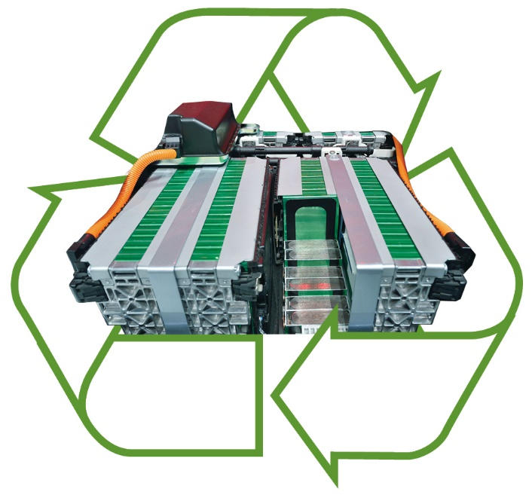
CORPORATE OBJECTIVE and STRATEGY
CORPORATE OBJECTIVE
A diversified critical metals company focusing on upcycling Lithium Ion Electric Vehicle Batteries.
CORPORATE STRATEGY
To recycle valuable cathode materials for the global lithium electric vehicle battery industry. The process eliminates the need for heat and furnaces, as the recovery of the metals take place at ambient temperatures. The result is a cleaner, environmentally sustainable, robust recycling alternative to current disposal methods.
Slide No. 7– May 9, 2017 AMERICAN MANGANESE INC. TSX.V: AMY PINK: AMYFZ FRANK: 2AM www.amymn.com

Slide 8
TECHNOLOGY HISTORY
The recycling opportunity currently underway has its roots in American Manganese Inc.’s technology for economically producing Electrolytic Metals (EM) from very low grade deposits located at Artillery Peak, Arizona. Normal process utilize grades from 35-55% Mn whereas Artillery grades range from 2-3%. Artillery Peak is the largest deposit of Manganese in the U.S. with a potential of billions of pounds available. Partially answers U.S. concern for Strategic Metals.
The process is patented in the U.S., China and South Africa. American Manganese was successful where the U.S. Bureau of Mines tried and failed to produce EM economically for approximately sixty years. Kemetco recognized the process could be adapted to Recycling Electric Vehicle Batteries.
Slide No. 8– May 9, 2017 AMERICAN MANGANESE INC. TSX.V: AMY PINK: AMYFZ FRANK: 2AM www.amymn.com

Slide 9
RECYCLING TECHNOLOGY
The following achievements have been realized as follows:
Cathode materials such as lithium, cobalt, nickel and manganese have returned extractions of 100%.
Precipitation tests have recovered 100% of cobalt and 87% of the lithium. Precipitation testing of nickel and manganese will be addressed in the current phase.
Production of rechargeable Lithium Cobalt prototype button batteries have been successfully completed.
A US provisional patent was applied for on November 11, 2016.
Slide No. 9 – May 9, 2017 AMERICAN MANGANESE INC. TSX.V: AMY PINK: AMYFZ FRANK: 2AM www.amymn.com

Slide 10
THE PROBLEM
Currently Recycling EV Batteries Consists Of Storage, Landfill, and/or Pyrometallurgical Processes (Burning In Smelters)
China Has Legislated That All EV Manufacturers And Importers Come Up With A Feasible Recycling Program
European Union Has Set A Timeline For Battery Manufactures And Importers To Recycle Spent Lithium Ion Batteries
Canada Has Three Provinces (British Columbia, Manitoba and Quebec) with Mandatory Recycling Programs
In the US there is no Federal Regulations for Battery Recycling, some States do.
Slide No. 10– May 9, 2017 AMERICAN MANGANESE INC. TSX.V: AMY PINK: AMYFZ FRANK: 2AM www.amymn.com

Slide 11
THE OPPORTUNITY
American Manganese Inc. Has Developed A Robust Recycling Solution that is Closed Loop and Reduces the Need For New Mines, Landfill Waste, Energy Consumption, Co₂ Emissions and Critical and Strategic Metal Consumption.
Slide No. 11– May 9, 2017 AMERICAN MANGANESE INC. TSX.V: AMY PINK: AMYFZ FRANK: 2AM www.amymn.com

Slide 12
CUSTOMERS
Battery Manufacturers
Electric Vehicle Manufacturers
Commodity Firms wanting Off-take Agreements
Large Corporations looking to partner on our Technology
Mining Companies Expanding into Different Mining Streams.
Oil Companies expanding into alternative energy
Slide No. 12– May 9, 2017 AMERICAN MANGANESE INC. TSX.V: AMY PINK: AMYFZ FRANK: 2AM www.amymn.com

Slide 13
MARKET SIZE
2015 - 276,000 EV Batteries reached the end of Life
2020 - 356,000 will reach their end of life
2025 - 849,000 will reach their end of life
2040 – Estimates of 40 million EV Vehicles will be in service
Emerging Lithium Ion Storage Batteries opens a huge new area of opportunity
Slide No. 13 – May 9, 2017 AMERICAN MANGANESE INC. TSX.V: AMY PINK: AMYFZ FRANK: 2AM www.amymn.com

Slide 14
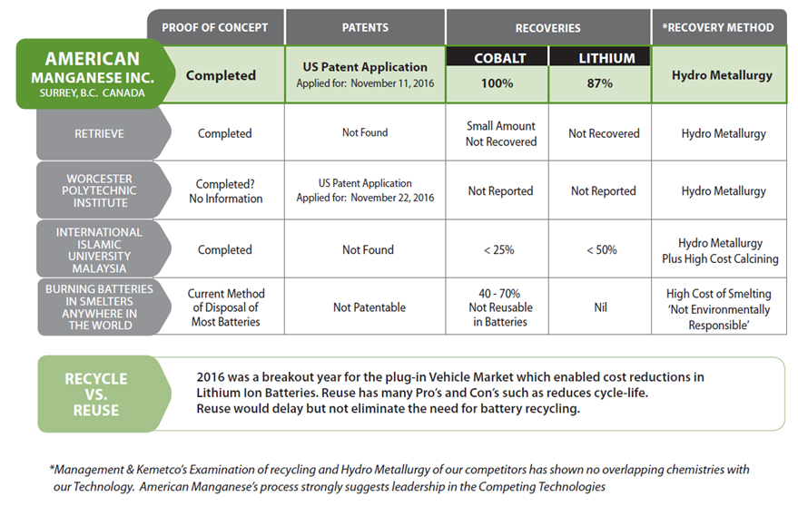
RECYCLING COMPETITORS
Slide No. 14– May 9, 2017 AMERICAN MANGANESE INC. TSX.V: AMY PINK: AMYFZ FRANK: 2AM www.amymn.com

Slide 15
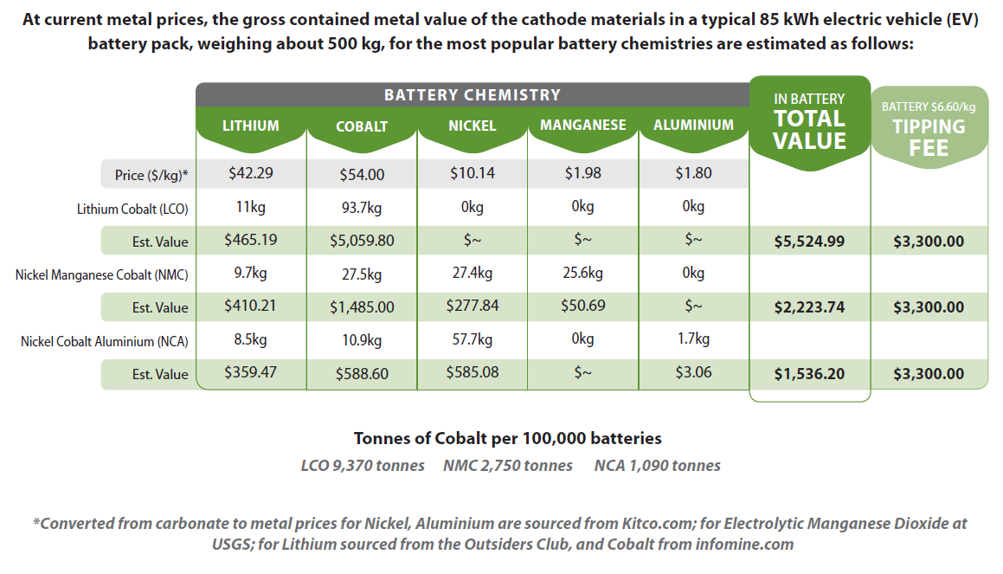
BATTERY CHEMISTRY and ECONOMICS
$3.00/lb
Slide No. 15– May 9, 2017 AMERICAN MANGANESE INC. TSX.V: AMY PINK: AMYFZ FRANK: 2AM www.amymn.com

Slide 16
CATHODE MATERICALS ARE CRITICAL and STRATEGIC
Cobalt: Currently in deficit supply, critical for Lithium Ion Batteries and up over 150% in the past year to $25.00/Lb. $54.00/Kg. (U.S.) – ($55,000/tonne)
Lithium: predicted to be in deficit supply trading at $9,000/tonne. In some cases $20,000/tonne in China
Nickel: Possibly entering deficit supply trading at $9,200/tonne
Manganese: bullish reports for electrolytic manganese dioxide for battery storage will significantly boost consumption. Currently $2,000/tonne
Aluminum: Currently $1,950/tonne
Slide No. 16– May 9, 2017 AMERICAN MANGANESE INC. TSX.V: AMY PINK: AMYFZ FRANK: 2AM www.amymn.com

Slide 17
COBALT PRODUCTION DYNAMICS
While global production of refined cobalt surged from 52,400 tons in 2005 to 99,000 tons in 2015, the bulk of the increase was attributable to new capacity from African copper mines. In addition to rigorous regulatory issues for companies that buy metals from African miners, metal production from African mines is not necessarily reliable.
Declining prices of nickel and copper inhibits new by product production.
According to the Cobalt Development Institute, the battery industry uses 41% of global cobalt supplies. Over the next 10 years, that percentage will increase to about 65%. While there is limited competition in the global markets for lithium. Cobalt provides the high energy density for Lithium Ion Batteries.
Tesla cannot launch a $35,000 Model 3 without a Giga-Factory that's operating at or near its design capacity of 35 GWh per year. This will require about 7,800 tonnes of cobalt per year.
The bottom line is, “AMY’S EV Battery Recycling Plan will alleviate the cobalt shortage and replace a large percentage of future mining requirements.”
Slide No. 17– May 9, 2017 AMERICAN MANGANESE INC. TSX.V: AMY PINK: AMYFZ FRANK: 2AM www.amymn.com

Slide 18
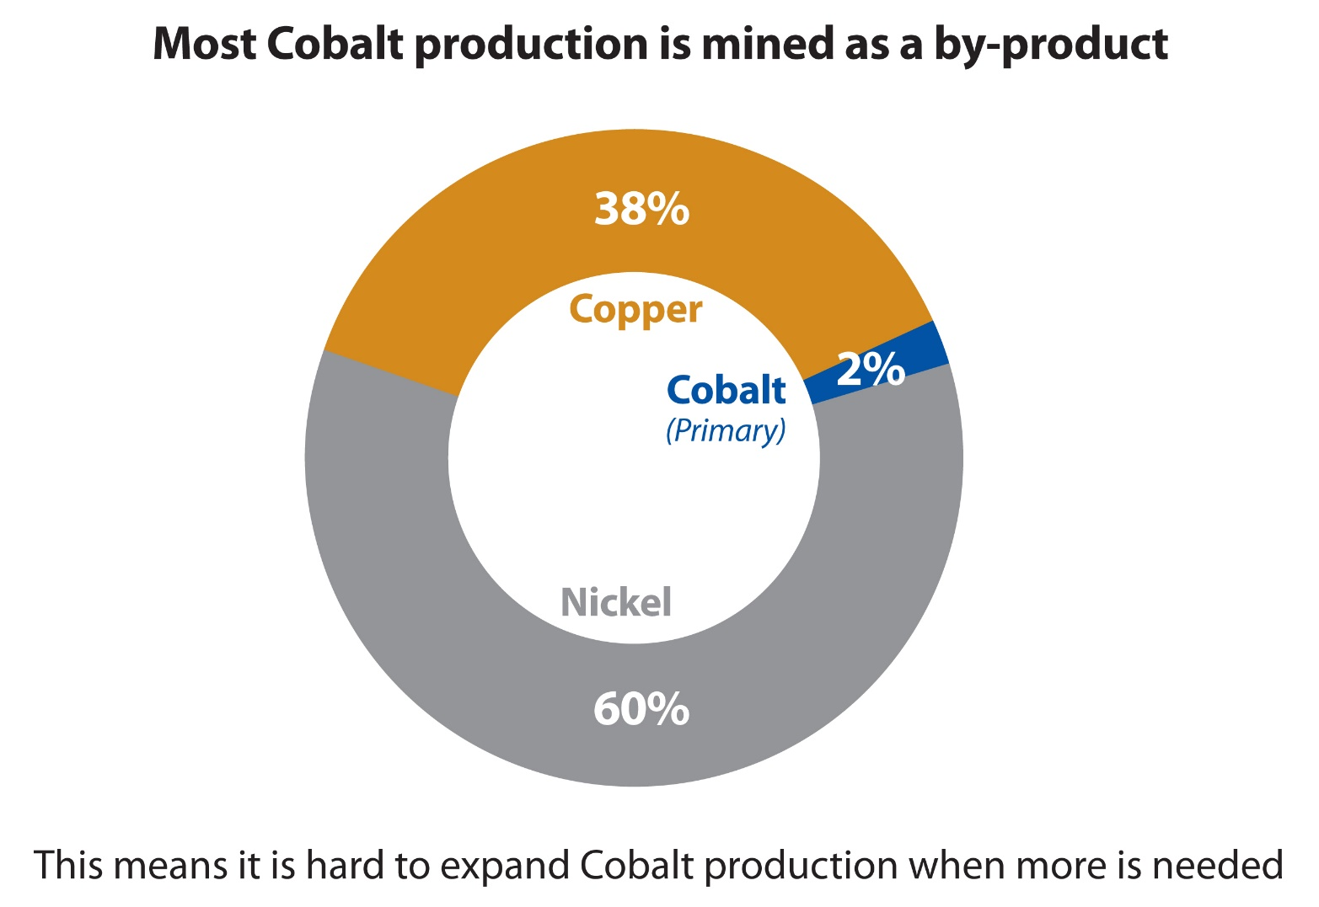
COBALT PRODUCTION
Slide No. 18 – May 9, 2017 AMERICAN MANGANESE INC. TSX.V: AMY PINK: AMYFZ FRANK: 2AM www.amymn.com

Slide 19
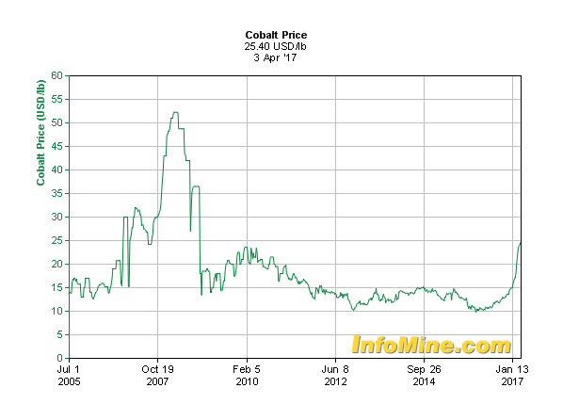
COBALT 12 YEAR CHART
$52.00/lb ($114.60 /Kg)
$25.40/lb ($56.00/Kg)
Slide No. 19 – May 9, 2017 AMERICAN MANGANESE INC. TSX.V: AMY PINK: AMYFZ FRANK: 2AM www.amymn.com

Slide 20
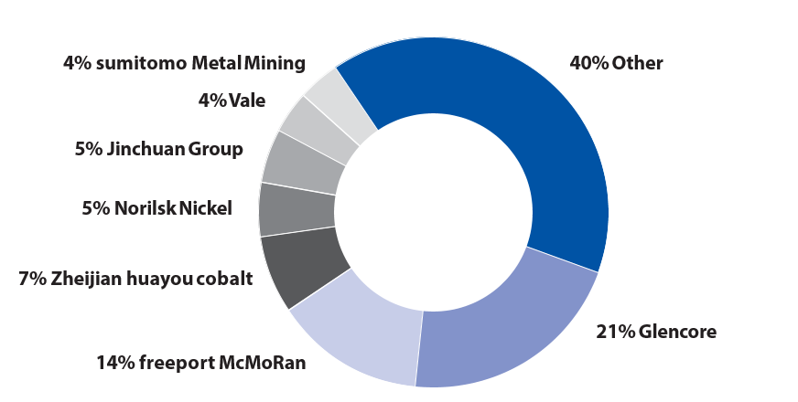
COBALT 100,000 TONNES PRODUCED ANNUALLY
96% of Cobalt Comes as a By-product of Mining Nickel and Copper Deposits.
56% is Produced In The Democratic Republic Of Congo a Country Sanctioned
for Human Rights Abuse.
50% of The World Cobalt is Refined in China.
Slide No. 20 – May 9, 2017 AMERICAN MANGANESE INC. TSX.V: AMY PINK: AMYFZ FRANK: 2AM www.amymn.com

Slide 21
GLOBAL LITHIUM PRICES
Slide No. 21 – May 9, 2017 AMERICAN MANGANESE INC. TSX.V: AMY PINK: AMYFZ FRANK: 2AM www.amymn.com

Slide 22
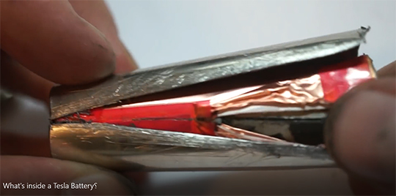
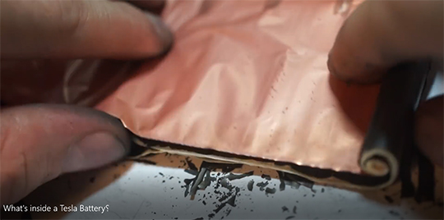
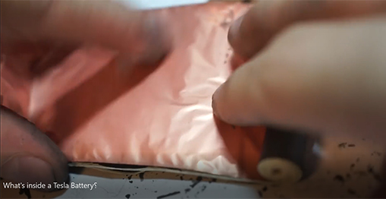
DISASSEMBLY OF A TESLA BATTERY
The Company is collaborating on Automating a Disassembly Line for Lithium Ion Battery Cells
Slide No. 22 – May 9, 2017 AMERICAN MANGANESE INC. TSX.V: AMY PINK: AMYFZ FRANK: 2AM www.amymn.com

Slide 23
MILESTONES
Completed Proof of Concept – 2016
Filed for US Provisional Patent – 2016
Raised a minimum of $2,000,000 - 2016
Completed Leaching Precipitation Testing on Lithium/Cobalt – 2017
Complete Leaching Precipitation Testing on Nickel/Manganese – 2017
File for Full U.S. Patent and Other Jurisdictions – 2017
Raise from $10-$25 Million dollars with Participation Partner – 2017-2018
Begin Pilot Plant build for Pilot testing work – 2018
Design Battery Disassembly Plant - 2018
Hire Engineering Firm to Estimate Costs of Operating and Capital Costs - 2018-2019
Complete Environmental Permitting - 2019
Raise Capital and Build Operating Portable Plant – 2019-2020
Slide No. 23– May 9, 2017 AMERICAN MANGANESE INC. TSX.V: AMY PINK: AMYFZ FRANK: 2AM www.amymn.com

Slide 24
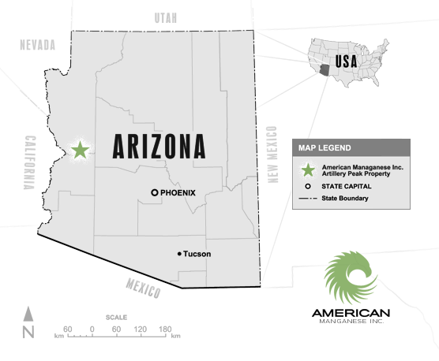
ARTILLERY PEAK, ARIZONA
ARTILLERY PEAK, ARIZONA Manganese Property (100% Ownership)
From 2007-2012 AMI completed 43-101 drilled resource estimates, pilot plant work with Kemetco and a pre-feasibility study with Tetra-Tech. Due to the price of manganese metals dropping to uneconomic levels the company discontinued work, eventually eliminating all of their leased holdings and retaining their BLM claims hosting the highest values of manganese from previously drilled
diamond drill holes. Work by Kemetco and Tetra-Tech proved the Company could produce electrolytic metals at prices that were competitive in production cost to the Chinese producers utilizing low grade (2-3%) ores compared to Chinese production grading 30-55%. The Company went on to produce rechargeable button cell batteries utilizing Artillery Peak ores.
Patents received are registered in the US, China and South Africa. These patents are the foundation of the Company’s US patent pending process for recycling cathode materials for Lithium Ion batteries.
Slide No. 24 – May 9, 2017 AMERICAN MANGANESE INC. TSX.V: AMY PINK: AMYFZ FRANK: 2AM www.amymn.com

Slide 25
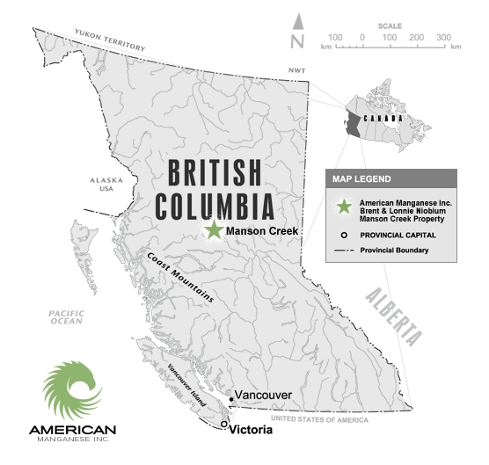
NIOBIUM PROPERTIES, BC
LONNIE and VIRGIL, BRITISH COLUMBIA Niobium/Lanthanum (Rare Earths)
(100% Ownership)
The Virgil and Lonnie carbonatite claims contain two showings defined by trenching (1970’s) with a combined strike length of 620 meters (2,040 ft.) with widths up to 40 meters grading 0.20% Niobium. A 56 meter chip sample on the Brent carbonatite assayed .05% Lanthanum, .03% Neodymium and .15% Titanium.
Air Bourne geophysics and geochemical field work identified four significant anomalies with soil sampling results approaching 1% total rare earths plus additional Niobium credits.
Slide No. 25 – May 9, 2017 AMERICAN MANGANESE INC. TSX.V: AMY PINK: AMYFZ FRANK: 2AM www.amymn.com

Slide 26
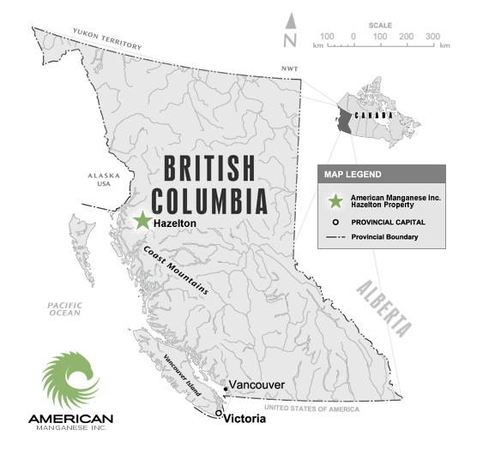
ROCHER DEBOULE PROPERTY, B.C.
ROCHER DEBOULE IOCG, BRITISH COLUMBIA Niobium/Lanthanum (Rare Earths)
(100% Ownership)
AMY’s Iron Oxide Copper Gold (IOCG) 1,000 (hectare) target is located 10 km from Hazelton, BC. The property contains several mineral occurrences over a 12 kilometer east, west direction.
The original Rocher Deboule mine and three other properties were mined and shipped to smelter by railroad as follows:
* One high-grade shipment of 23 tons averaged 6.25 opt Gold, Silver (8.70 opt) Copper (7.0%), Cobalt (2.5%) and Molybdenum (1.15%). Soil and rock sampling, mapping and magnetometer surveys in 2011-2016 have identified three (3) bulk tonnage targets, within the claim group.
Slide No. 26 – May 9, 2017 AMERICAN MANGANESE INC. TSX.V: AMY PINK: AMYFZ FRANK: 2AM www.amymn.com

Slide 27
SUMMARY
Leader in Lithium Ion Electric Vehicle Battery Recycling
Mining Batteries Eliminates Mining Ore
Valuable Cathode Materials (Cobalt) Delivered to Our Door Step ($3.00/lb Tipping Fee)
Business Opportunity in Recycling Plants
Equity Investment Participation in Disruptive Technology Critical to the Production of Electric Cars
Slide No. 27 – May 9, 2017 AMERICAN MANGANESE INC. TSX.V: AMY PINK: AMYFZ FRANK: 2AM www.amymn.com

Slide 28
CONTACT INFORMATION
CONTACT
Larry W. Reaugh, President, C.E.O. and Director
17942 55th Avenue, Suite #2
White Rock, B.C. V4B 1E6
Ph.: 778-574-4444
Email: lreaugh@amymn.com
Website: www.americanmanganeseinc.com
Slide No. 28 – May 9, 2017 AMERICAN MANGANESE INC. TSX.V: AMY PINK: AMYFZ FRANK: 2AM www.amymn.com

